Slide 1
Ch – 5 Tracking Result & Measuring Success An Evolving Art For : The Future Of SEO

Slide 2
Content :
Why Measuring Success is Essential to the SEO Process
Measuring Search Traffic
Typing SEO to Conversion and ROI
Competitive and Diagnostic Search Metrics key Performance
Indicator For Long Tail SEO

Slide 3
The Ongoing Evolution Of Search
More Searchable Content and Content Types
Search Becoming More personalized and User Influenced
Increasing Important of Local , Media and Voice Recognition Search
Increased Market Saturation and Competition
SEO As an Enduring Art Form

Slide 4
Why Measuring Success is Essential to the SEO Process :
Although quantifying deliverables and measuring progress are important for external reporting purposes, it is just as important for SEO practitioners to measure the efficacy of their own efforts so they can make timely adjustments as necessary.
As you will see in this chapter, numerous tools are available to aid in this process.

Slide 5
• Quantifying organic search traffic by search engine and keyword
• Identifying poorly performing pages
• Identifying the best-performing pages (in terms of traffic and conversions)
• Tracking search engine crawler activity on the site
• Determining the number of indexed pages
• Determining whether the indexed pages are getting search traffic
• Determining whether best-selling product pages are indexed and getting search traffic

Slide 6
The best data measurements are those that potentially result in an action being taken in response.
Think of this as data-driven decision making.
The Tracking Cycle: Produce, Launch, Measure, Refine :
1. Define an SEO campaign and set goals.
2. Discuss your strategy.
3. Establish a baseline.
4. Proceed with your project.
5. Collect data.
6. Refine your campaign.

Slide 7
Using Analytics as a Business Case for SEO : You could include a variety of metrics in a business case, such as :
• Revenue
• Lead generation
• Margin
• Branding value
• Reach
• Other action triggers (newsletter sign-ups, contact requests, demo requests, accepting a free trial, viewing a specific piece of content, etc.)

Slide 8
Measuring Search Traffic :
Classic web analytics data is an incredible asset to SEO.
Here are some examples of ways to utilize this data for SEO purposes :
• Look at your daily referral reports to detect newly received inbound links..
• Look at the search terms people use to come to your site to spot long-tail search opportunities.

Slide 9
• Measure the results of your campaigns by tracking the increase in conversions you are driving over time.
- Web analytics are a must-have for any web publisher.

Slide 10
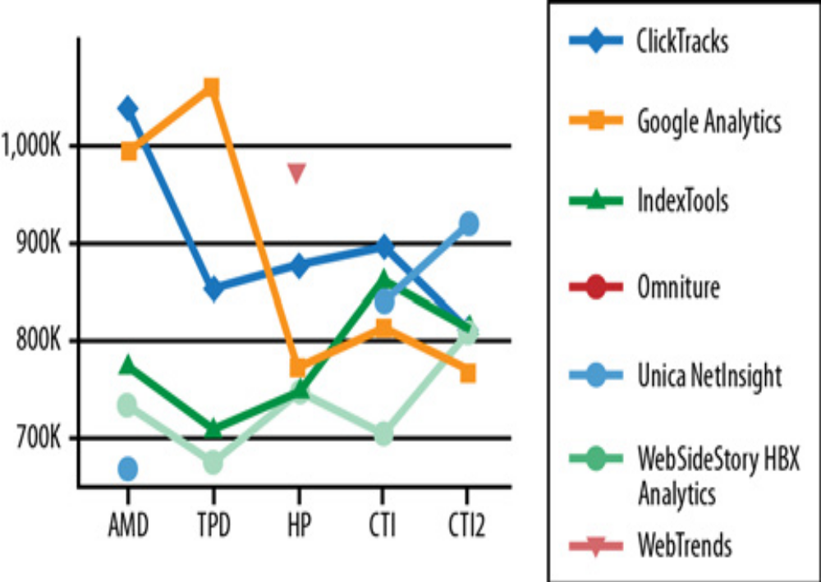

Slide 11
Typing SEO to Conversion and ROI :
It is important to tie your SEO campaign to the results it brings to the business.
Key to that is measuring the conversions driven by organic SEO traffic.
Here are some of the most common types of conversions :
- Sales/sales revenue :
- Email /blog /newsletter subscriptions :
- Sign-ups :

Slide 12
- Downloads :
- Contact forms and phone calls :
- Visitors who share :
- Visitors who link :
- Visitors who publicize :

Slide 13
Competitive and Diagnostic Search Metrics :
we have focused on the basics—the dollars and cents of determining whether you have succeeded in your SEO campaign.
As we noted at the beginning of the chapter, these should be your first priority in your analytics efforts.
In this section, we will start looking at metrics that you can use to diagnose specific SEO issues.

Slide 14
An example of this would be finding out that a major section of your site is not indexed.
Another example is seeing how your traffic growth compares to that of your competitors….
Search Engine and Competitive Metrics : Numerous tools allow you to monitor your site and those of your competitors, providing insight into your SEO progress.
You can also use these tools to figure out what your competitors are doing from an SEO perspective.

Slide 15
This type of intelligence can provide you with new ideas on how to adapt your strategy to get better results.
Better knowledge of your competitors’ strategy is certainly one valuable goal.

Slide 16
The Ongoing Evolution Of Search :
Search has come a long way, and will continue to progress at a faster and faster pace.
Keeping up with these changes, the competitive environment, and new and emerging technologies provides both a challenge and an opportunity.

Slide 17
More Searchable Content and Content Types :
The emphasis throughout this book has been on providing the crawlers with textual content semantically marked up using HTML.
However, the less accessible document types—such as multimedia, content behind forms, and scanned historical documents—are being integrated into the search engine results pages (SERPs) more and more………

Slide 18
As search algorithms evolve in the ways that the data is collected, parsed, and interpreted.
Engines Will Make Crawling Improvements
Engines Are Getting New Content Sources
Multimedia Is Becoming Indexable

Slide 19
Search Becoming More personalized and User Influenced :
Personalization efforts have been underway at the search engines for some time.
As we discussed earlier in this book, the most basic form of personalization is to perform an IP location lookup to determine where the searcher is located, and tweak the results based on that location.

Slide 20
However, the search engines continue to explore additional ways to expand on this simple concept to deliver better results for each user.
It is not yet clear whether personalization has given the engines that have invested heavily in it better results overall or greater levels of user satisfaction..
But their continued use of the technology suggests that, at the least, their internal user satisfaction tests have been positive.

Slide 21
Increasing Important of Local , Media and Voice Recognition Search :
New forms of vertical search are becoming increasingly important.
Areas that the search engines have already embraced include local search and mobile search.
In addition, voice recognition–based search is an area in which all the major engines are actively investing.

Slide 22
Local Search : Local search was an active business before the advent of the Internet, when the Yellow Pages as supplied by your phone company were the tool of choice.
As the World Wide Web gained prominence in our lives, the Yellow Pages began migrating online.
Some of the major players are CitySearch, Local.com, and Superpages.
You can find these local search engines at ( http://maps.google.com , http://local.yahoo.com , and http://www.bing.com/maps) .

Slide 23
Mobile Search : With over 1 billion mobile phones in use worldwide (http://www.digitalbuzzblog.com/2011-mobile ), the opportunity for mobile search has begun to grow rapidly…
An April 2011 Google study showed that search engines were the most visited sites on mobile devices, with 77% of those surveyed reporting their use (http://www.clickz.com/clickz/ ).

Slide 24
The ever-expanding versatility and power of tablet and mobile devices—from indispensable utility apps, to immersive multimedia players, to massively multiplayer online games, to paradigm-shifting hardware advances such as the iPhone’s multitouch display, proximity sensor, GPS, and gyroscopes—will fuel this growth.

Slide 25
Voice-Recognition Search : When users are mobile they must deal with the limitations of their mobile devices, specifically the small screen and small keyboard.
Voice search could be a great way to improve the mobile search experience.
Speech recognition technology has been around for a long time, and the main challenge has always been that it requires a lot of computing power.

Slide 26
Increased Market Saturation and Competition :
One thing you can count on with the Web is continued growth.
Despite its constantly growing index, a lot of the pages in Google may be low-quality or duplicate-content-type pages that will never see the light of day.
The Web is a big place, but one where the signal-to-noise ratio is very low.
One major trend emerges from an analysis of Internet usage statistics.

Slide 27
According to Miniwatts Marketing Group, as of March 2011, 78.3% of the North American population were using the Internet (http://www.internetworldstats.com/stats.htm ), so there is not much room for growth here.
This data is telling us that in terms of the number of users, North America is already approaching saturation.
There is some room for growth in Europe and Oceania/Australia, where penetration rates hover at around 60%, but not that much……..

Slide 28
SEO As an Enduring Art Form :
Today, SEO can be fairly easily categorized as having five major objectives :
• Make content accessible to search engine crawlers.
• Find the keywords that searchers employ (i.e., understand your target audience) and make your site speak their language.
• Build content that users will find useful, valuable, and worthy of sharing.

Slide 29
• Earn votes for your content in the form of editorial links and social media mentions from good sources by building inviting , shareable content and applying classic marketing techniques to the online world.
• Create web pages that allow users to find what they want extremely quickly, ideally in the blink of an eye.

